Slide 1
Binary Search Tree

Slide 2
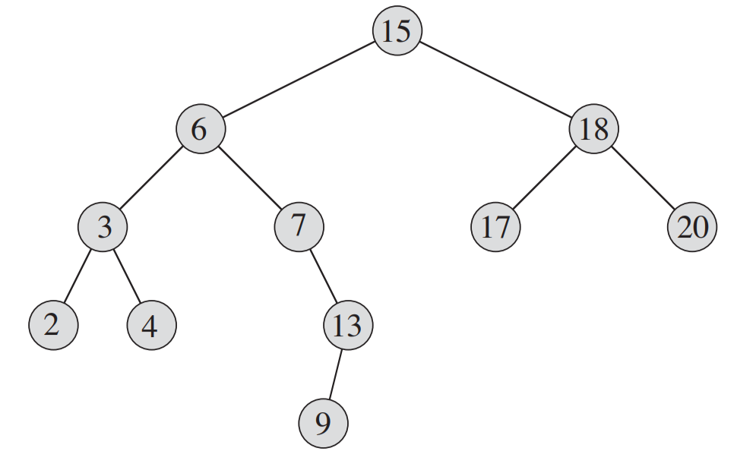
Recall This From DM
Previously we performed only insertion

Slide 3
Binary Search Tree - Intro
A binary search tree (BST) is a node-based binary tree data structure which has the following properties:
The left subtree of a node contains only nodes with keys (values) less than the node's key.
The right subtree of a node contains only nodes with keys greater than or equal to the node's key.
Both the left and right subtrees must also be binary search trees.

Slide 4
Two Things To Keep In Mind
1. Terms and complexity
It is a binary tree represented by a linked data structure
It combines the advantage of an array - the ability to do a binary search with the advantage of a linked list its dynamic size
The efficiency of all of the operations is O(h) = O(log n), only if the tree is reasonably height-balanced
Each node contains at least the following fields
key: an identifying field
left: pointer to a left child (may be NIL)
right: pointer to a right child (may be NIL)
p: pointer to the parent node (NIL for root)

Slide 5
Two Things To Keep In Mind
2. Binary Search Property
For any node x
key [y] < key [x] if y in left subtree of x
key [y] ≥ key [x] if y in right subtree of x

Slide 6
Binary Search Tree Operations
The search tree data structure supports many dynamic-set operations, including
SEARCH
MINIMUM
MAXIMUM
PREDECESSOR
SUCCESSOR
INSERT
DELETE.

Slide 7
Search
We can do it recursively or iteratively
15
The functions takes a pointer to a node and the value to be searched as input.
The function then places a pointer x at the same node.
Using that pointer the function checks if the value is equal.
If it is equal then a pointer to that node is returned.
If the key is greater than that value
The function calls another function on the right child
If the key is smaller than that value
The function calls another function on the left child
6
18
3
7
17
20
2
4
13
9

Slide 8
Search
We can do it recursively or iteratively
x-pointer
15
TreeSearch(root,9)
The functions takes a pointer to a node and the value to be searched as input.
The function then places a pointer x at the same node.
Using that pointer the function checks if the value is equal.
If it is equal then a pointer to that node is returned.
If the key is greater than that value
The function calls another function on the right child
If the key is smaller than that value
The function calls another function on the left child
6
18
3
7
17
20
2
4
13
9

Slide 9
Search
We can do it recursively or iteratively
x-pointer
15
TreeSearch(root,9)
The functions takes a pointer to a node and the value to be searched as input.
The function then places a pointer x at the same node.
Using that pointer the function checks if the value is equal.
If it is equal then a pointer to that node is returned.
If the key is greater than that value
The function calls another function on the right child
If the key is smaller than that value
The function calls another function on the left child
TreeSearch(x->left,9)
x-pointer
6
18
3
7
17
20
2
4
13
9

Slide 10
Search
We can do it recursively or iteratively
x-pointer
15
TreeSearch(root,9)
The functions takes a pointer to a node and the value to be searched as input.
The function then places a pointer x at the same node.
Using that pointer the function checks if the value is equal.
If it is equal then a pointer to that node is returned.
If the key is greater than that value
The function calls another function on the right child
If the key is smaller than that value
The function calls another function on the left child
TreeSearch(x->left,9)
x-pointer
6
18
TreeSearch(x->right,9)
3
7
x-pointer
17
20
2
4
13
9

Slide 11
Search
We can do it recursively or iteratively
x-pointer
15
TreeSearch(root,9)
The functions takes a pointer to a node and the value to be searched as input.
The function then places a pointer x at the same node.
Using that pointer the function checks if the value is equal.
If it is equal then a pointer to that node is returned.
If the key is greater than that value
The function calls another function on the right child
If the key is smaller than that value
The function calls another function on the left child
TreeSearch(x->left,9)
x-pointer
6
18
TreeSearch(x->right,9)
3
7
x-pointer
17
20
TreeSearch(x->right,9)
2
4
13
x-pointer
9

Slide 12
Search
We can do it recursively or iteratively
x-pointer
15
TreeSearch(root,9)
The functions takes a pointer to a node and the value to be searched as input.
The function then places a pointer x at the same node.
Using that pointer the function checks if the value is equal.
If it is equal then a pointer to that node is returned.
If the key is greater than that value
The function calls another function on the right child
If the key is smaller than that value
The function calls another function on the left child
TreeSearch(x->left,9)
x-pointer
6
18
TreeSearch(x->right,9)
3
7
x-pointer
17
20
TreeSearch(x->right,9)
2
4
13
x-pointer
TreeSearch(x->left,9)
9
x-pointer

Slide 13
Search
We can do it recursively or iteratively
x-pointer
15
TreeSearch(root,9)
The functions takes a pointer to a node and the value to be searched as input.
The function then places a pointer x at the same node.
Using that pointer the function checks if the value is equal.
If it is equal then a pointer to that node is returned.
If the key is greater than that value
The function calls another function on the right child
If the key is smaller than that value
The function calls another function on the left child
TreeSearch(x->left,9)
x-pointer
6
18
TreeSearch(x->right,9)
3
7
x-pointer
17
20
TreeSearch(x->right,9)
2
4
13
x-pointer
TreeSearch(x->left,9)
9
x-pointer
This pointer is returned
until the root is reached

Slide 14
Search
We can do it recursively or iteratively
x-pointer
15
TreeSearch(root,14)
The functions takes a pointer to a node and the value to be searched as input.
The function then places a pointer x at the same node.
Using that pointer the function checks if the value is equal.
If it is equal then a pointer to that node is returned.
If the key is greater than that value
The function calls another function on the right child
If the key is smaller than that value
The function calls another function on the left child
6
18
3
7
17
20
2
4
13
9

Slide 15
Search (Another Example)
We can do it recursively or iteratively
15
TreeSearch(root,14)
The functions takes a pointer to a node and the value to be searched as input.
The function then places a pointer x at the same node.
Using that pointer the function checks if the value is equal.
If it is equal then a pointer to that node is returned.
If the key is greater than that value
The function calls another function on the right child
If the key is smaller than that value
The function calls another function on the left child
6
18
3
7
17
20
2
4
13
9

Slide 16
Search (Another Example)
We can do it recursively or iteratively
x-pointer
15
TreeSearch(root,14)
The functions takes a pointer to a node and the value to be searched as input.
The function then places a pointer x at the same node.
Using that pointer the function checks if the value is equal.
If it is equal then a pointer to that node is returned.
If the key is greater than that value
The function calls another function on the right child
If the key is smaller than that value
The function calls another function on the left child
6
18
3
7
17
20
2
4
13
9

Slide 17
Search (Another Example)
We can do it recursively or iteratively
x-pointer
15
TreeSearch(root,14)
The functions takes a pointer to a node and the value to be searched as input.
The function then places a pointer x at the same node.
Using that pointer the function checks if the value is equal.
If it is equal then a pointer to that node is returned.
If the key is greater than that value
The function calls another function on the right child
If the key is smaller than that value
The function calls another function on the left child
TreeSearch(x->left,14)
6
18
3
7
17
20
2
4
13
9

Slide 18
Search (Another Example)
We can do it recursively or iteratively
x-pointer
15
TreeSearch(root,14)
The functions takes a pointer to a node and the value to be searched as input.
The function then places a pointer x at the same node.
Using that pointer the function checks if the value is equal.
If it is equal then a pointer to that node is returned.
If the key is greater than that value
The function calls another function on the right child
If the key is smaller than that value
The function calls another function on the left child
TreeSearch(x->left,14)
x-pointer
6
18
3
7
17
20
2
4
13
9

Slide 19
Search (Another Example)
We can do it recursively or iteratively
x-pointer
15
TreeSearch(root,14)
The functions takes a pointer to a node and the value to be searched as input.
The function then places a pointer x at the same node.
Using that pointer the function checks if the value is equal.
If it is equal then a pointer to that node is returned.
If the key is greater than that value
The function calls another function on the right child
If the key is smaller than that value
The function calls another function on the left child
TreeSearch(x->left,14)
x-pointer
6
18
TreeSearch(x->right,14)
3
7
17
20
2
4
13
9

Slide 20
Search (Another Example)
We can do it recursively or iteratively
x-pointer
15
TreeSearch(root,14)
The functions takes a pointer to a node and the value to be searched as input.
The function then places a pointer x at the same node.
Using that pointer the function checks if the value is equal.
If it is equal then a pointer to that node is returned.
If the key is greater than that value
The function calls another function on the right child
If the key is smaller than that value
The function calls another function on the left child
TreeSearch(x->left,14)
x-pointer
6
18
TreeSearch(x->right,14)
3
7
x-pointer
17
20
2
4
13
9

Slide 21
Search (Another Example)
We can do it recursively or iteratively
x-pointer
15
TreeSearch(root,14)
The functions takes a pointer to a node and the value to be searched as input.
The function then places a pointer x at the same node.
Using that pointer the function checks if the value is equal.
If it is equal then a pointer to that node is returned.
If the key is greater than that value
The function calls another function on the right child
If the key is smaller than that value
The function calls another function on the left child
TreeSearch(x->left,14)
x-pointer
6
18
TreeSearch(x->right,14)
3
7
x-pointer
17
20
TreeSearch(x->right,14)
2
4
13
9

Slide 22
Search (Another Example)
We can do it recursively or iteratively
x-pointer
15
TreeSearch(root,14)
The functions takes a pointer to a node and the value to be searched as input.
The function then places a pointer x at the same node.
Using that pointer the function checks if the value is equal.
If it is equal then a pointer to that node is returned.
If the key is greater than that value
The function calls another function on the right child
If the key is smaller than that value
The function calls another function on the left child
TreeSearch(x->left,14)
x-pointer
6
18
TreeSearch(x->right,14)
3
7
x-pointer
17
20
TreeSearch(x->right,14)
2
4
13
x-pointer
9

Slide 23
Search (Another Example)
We can do it recursively or iteratively
x-pointer
15
TreeSearch(root,14)
The functions takes a pointer to a node and the value to be searched as input.
The function then places a pointer x at the same node.
Using that pointer the function checks if the value is equal.
If it is equal then a pointer to that node is returned.
If the key is greater than that value
The function calls another function on the right child
If the key is smaller than that value
The function calls another function on the left child
TreeSearch(x->left,14)
x-pointer
6
18
TreeSearch(x->right,14)
3
7
x-pointer
17
20
TreeSearch(x->right,14)
2
4
13
x-pointer
9
TreeSearch(x->right,14)

Slide 24
Search (Another Example)
We can do it recursively or iteratively
x-pointer
15
TreeSearch(root,14)
The functions takes a pointer to a node and the value to be searched as input.
The function then places a pointer x at the same node.
Using that pointer the function checks if the value is equal.
If it is equal then a pointer to that node is returned.
If the key is greater than that value
The function calls another function on the right child
If the key is smaller than that value
The function calls another function on the left child
TreeSearch(x->left,14)
x-pointer
6
18
TreeSearch(x->right,14)
3
7
x-pointer
17
20
TreeSearch(x->right,14)
2
4
13
x-pointer
9
TreeSearch(x->right,14)
x-pointer

Slide 25
Search (Another Example)
We can do it recursively or iteratively
x-pointer
15
TreeSearch(root,14)
The functions takes a pointer to a node and the value to be searched as input.
The function then places a pointer x at the same node.
Using that pointer the function checks if the value is equal.
If it is equal then a pointer to that node is returned.
If the key is greater than that value
The function calls another function on the right child
If the key is smaller than that value
The function calls another function on the left child
TreeSearch(x->left,14)
x-pointer
6
18
TreeSearch(x->right,14)
3
7
x-pointer
17
20
TreeSearch(x->right,14)
2
4
13
x-pointer
9
TreeSearch(x->right,14)
x-pointer
A NULL pointer
is returned

Slide 26
Search (Let us Write The Code)

Slide 27
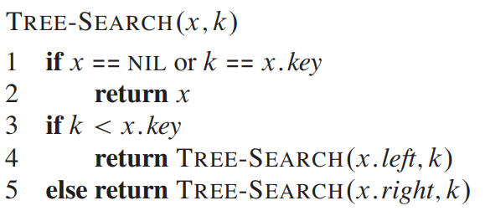
Search (Let us Write The Code)
Recursive

Slide 28
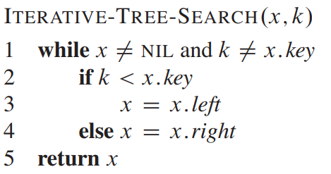
Search (Let us Write The Code)
Iterative
Simulate this code on the previous tree by yourself

Slide 29
Finding the Minimum and Maximum Value
15
6
18
3
7
17
20
2
4
13
9

Slide 30
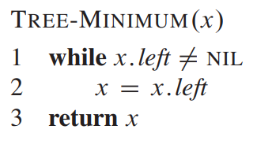
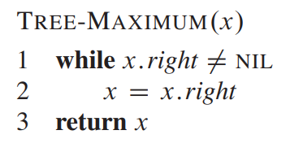
Finding the Minimum and Maximum Value
x-pointer
15
6
18
3
7
17
20
2
4
13
9

Slide 31
Finding the Minimum and Maximum Value
15
x-pointer
6
18
3
7
17
20
2
4
13
9

Slide 32
Finding the Minimum and Maximum Value
15
6
18
x-pointer
3
7
17
20
2
4
13
9

Slide 33
Finding the Minimum and Maximum Value
15
6
18
3
7
17
20
x-pointer
2
4
13
9

Slide 34
Finding the Minimum and Maximum Value
15
6
18
3
7
17
20
x-pointer
2
4
13
Loop Breaks.
X pointer is returned
9

Slide 35
Successor and Predecessor
Notes:
Successor – immediate larger node
Predecessor – immediate smaller node

Slide 36
Successor and Predecessor
Successor of a node:
If a node has a right child, the successor is the leftmost node in the right subtree.
If a node does not have a right child, then the successor is the nearest ancestor of the node for which this node would be in its left subtree.
Notes:
Successor – immediate larger node

Slide 37
Successor and Predecessor
Successor of a node:
If a node has a right child, the successor is the leftmost node in the right subtree.
If a node does not have a right child, then the successor is the nearest ancestor of the node for which this node would be in its left subtree.
x
15
CASE 1: Node has a right child
Successor (root) - > 17
6
18
3
7
17
20
2
4
13
9

Slide 38
Successor and Predecessor
Successor of a node:
If a node has a right child, the successor is the leftmost node in the right subtree.
If a node does not have a right child, then the successor is the nearest ancestor of the node for which this node would be in its left subtree.
15
CASE 1: Node has a right child
Successor (root) - > 17
6
18
CASE 2: No Right Child
Successor (x) - > 6
3
x
7
17
20
2
4
13
9

Slide 39
Predecessor of a Node
Predecessor of a node (Mirror of the previous definition)
If a node has a left child: The predecessor is the rightmost node in the left subtree.
If a node does not have a left child: The predecessor is the nearest ancestor of the node for which this node would be in its right subtree.

Slide 40
Predecessor of a Node
Predecessor of a node (Mirror of the previous definition)
If a node has a left child: The predecessor is the rightmost node in the left subtree.
If a node does not have a left child: The predecessor is the nearest ancestor of the node for which this node would be in its right subtree.
x
15
CASE 1: Node has a left child
Predecessor (root) - > 13
6
18
CASE 2: No Left Child
3
7
17
20
2
4
13
9

Slide 41
Predecessor of a Node
Predecessor of a node (Mirror of the previous definition)
If a node has a left child: The predecessor is the rightmost node in the left subtree.
If a node does not have a left child: The predecessor is the nearest ancestor of the node for which this node would be in its right subtree.
15
CASE 1: Node has a left child
Predecessor (root) - > 13
6
18
x
CASE 2: No Left Child
Predecessor (x) - > 15
3
7
17
20
2
4
13
9

Slide 42
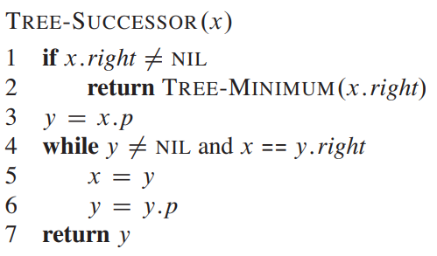
Determining the Successor : Simulation
CASE 1: Node has a right child
Leftmost node in the right subtree.
Successor (root) - > 17
15
6
18
3
7
17
20
2
4
13
9

Slide 43
Determining the Successor : Simulation
CASE 1: Node has a right child
Leftmost node in the right subtree.
Successor (root) - > 17
15
6
18
3
7
17
20
2
4
13
9

Slide 44
Determining the Successor : Simulation
CASE 2: Node has no right child
The nearest ancestor of the node
for which this node would
be in its right subtree.
Successor (x) - > 6
15
6
18
3
7
17
20
2
4
x
13
3.5
5
9

Slide 45
Determining the Successor : Simulation
CASE 2: Node has no right child
The nearest ancestor of the node
for which this node would
be in its right subtree.
Successor (x) - > 6
15
6
18
3
7
y
17
20
2
4
x
13
3.5
5
9

Slide 46
Determining the Successor : Simulation
CASE 2: Node has no right child
The nearest ancestor of the node
for which this node would
be in its right subtree.
Successor (x) - > 6
15
6
18
3
7
y
17
20
2
4
x
13
3.5
5
9

Slide 47
Determining the Successor : Simulation
CASE 2: Node has no right child
The nearest ancestor of the node
for which this node would
be in its right subtree.
Successor (x) - > 6
15
6
18
3
7
y
x
17
20
2
4
13
3.5
5
9

Slide 48
Determining the Successor : Simulation
CASE 2: Node has no right child
The nearest ancestor of the node
for which this node would
be in its right subtree.
Successor (x) - > 6
15
y
6
18
3
7
x
17
20
2
4
13
3.5
5
9

Slide 49
Determining the Successor : Simulation
CASE 2: Node has no right child
The nearest ancestor of the node
for which this node would
be in its right subtree.
Successor (x) - > 6
15
y
6
18
3
7
x
17
20
2
4
13
3.5
5
9

Slide 50
Determining the Successor : Simulation
CASE 2: Node has no right child
The nearest ancestor of the node
for which this node would
be in its right subtree.
Successor (x) - > 6
15
y
x
6
18
3
7
17
20
2
4
13
3.5
5
9

Slide 51
Determining the Successor : Simulation
CASE 2: Node has no right child
The nearest ancestor of the node
for which this node would
be in its right subtree.
Successor (x) - > 6
15
y
x
6
18
3
7
17
20
2
4
13
3.5
5
9

Slide 52
Determining the Successor : Simulation
CASE 2: Node has no right child
The nearest ancestor of the node
for which this node would
be in its right subtree.
Successor (x) - > 6
15
y
x
6
18
3
7
17
20
2
4
13
3.5
5
9

Slide 53
Determining the Successor : Simulation
CASE 2: Node has no right child
The nearest ancestor of the node
for which this node would
be in its right subtree.
Successor (x) - > 6
This y is returned
15
y
x
6
18
3
7
17
20
2
4
13
3.5
5
9

Slide 54
Write down a similar code for predecessor

Slide 55
Next Class
Discussing Complexity
Insert Function
Delete Function

Slide 56
Thank You

